Slide 1

Monroe County Council
Talk about money
Monroe County Council Work Session Meeting held Jan 24 2023 (Available on CATS)
Federal Monies for “Health and Public Safety”, ~10M of ~26M already spent. ~17M up for debate.

Slide 2
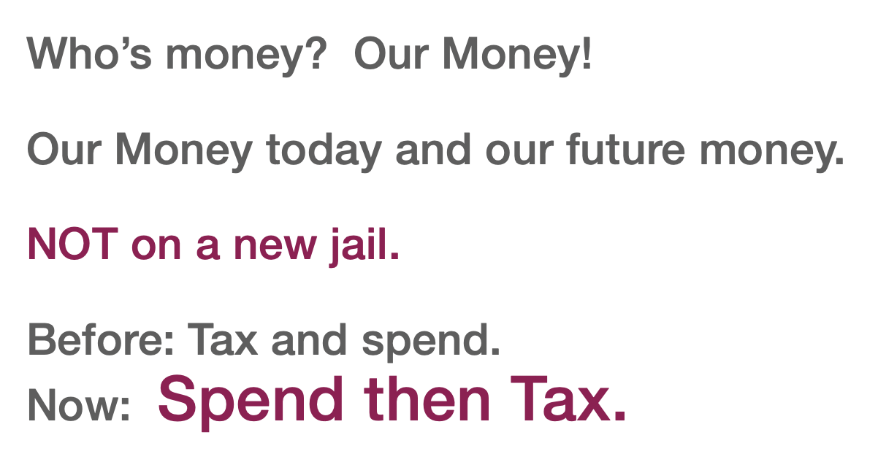

Slide 3
our money
Income Tax -
Local Income Tax - Monroe county monies given to programs through legislative action
State Income Tax - State monies given to Monroe County - through legislative action, some of these monies go directly to Not-For-Profit companies;(bypassing Local Government?)
Federal Income Tax - Federal monies given to Not-For-Profit companies which provide care to qualifying people in Monroe County (Health Care, Mental Health Care, Disability, Youth )
Indiana Property Tax Revenue
Indiana Sales and other taxes
Fees, fines and permits

Slide 4
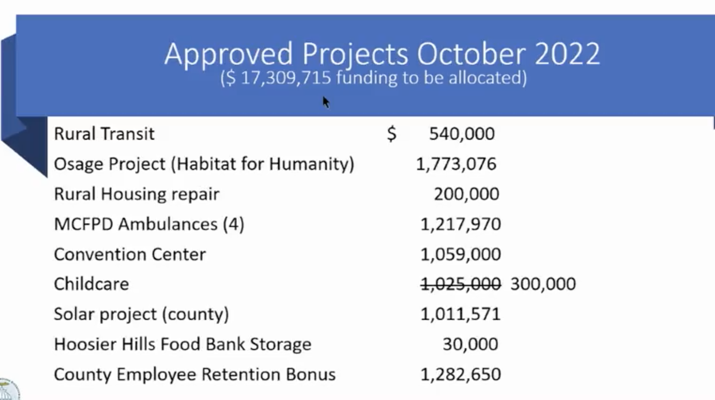

ARPA Funds discussion/presentation 1/24/2023
Monroe County Council work session

Slide 5
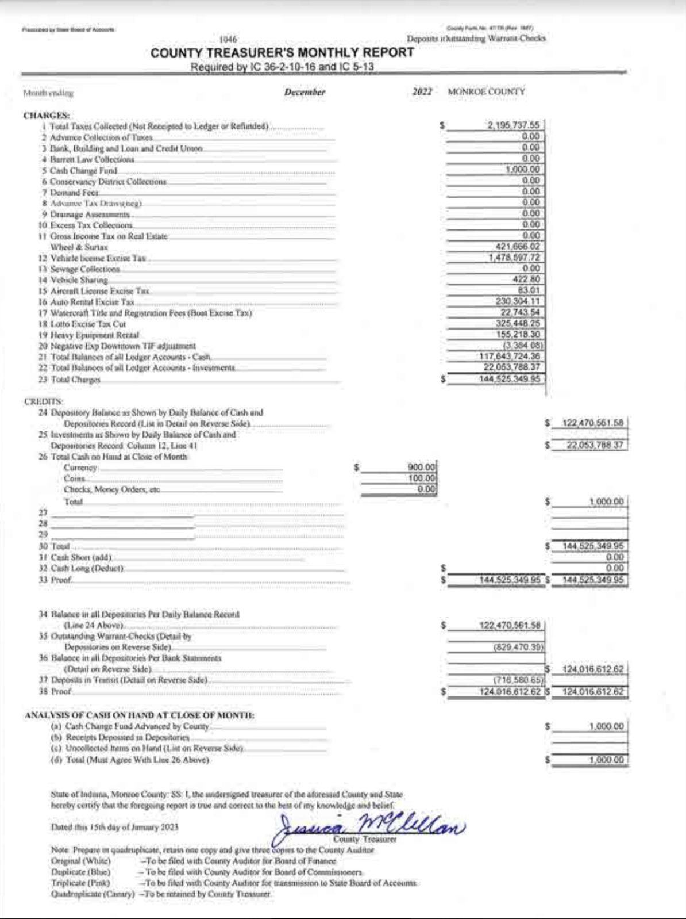
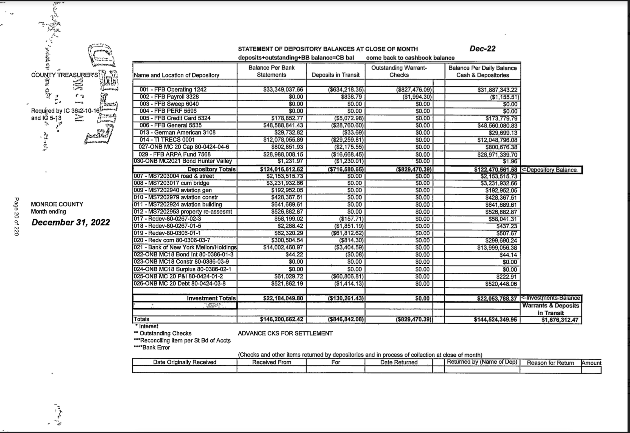
Signed and filed Monroe County Budget and reports

Slide 6
County Treasure’s MonthlyReport

Slide 8
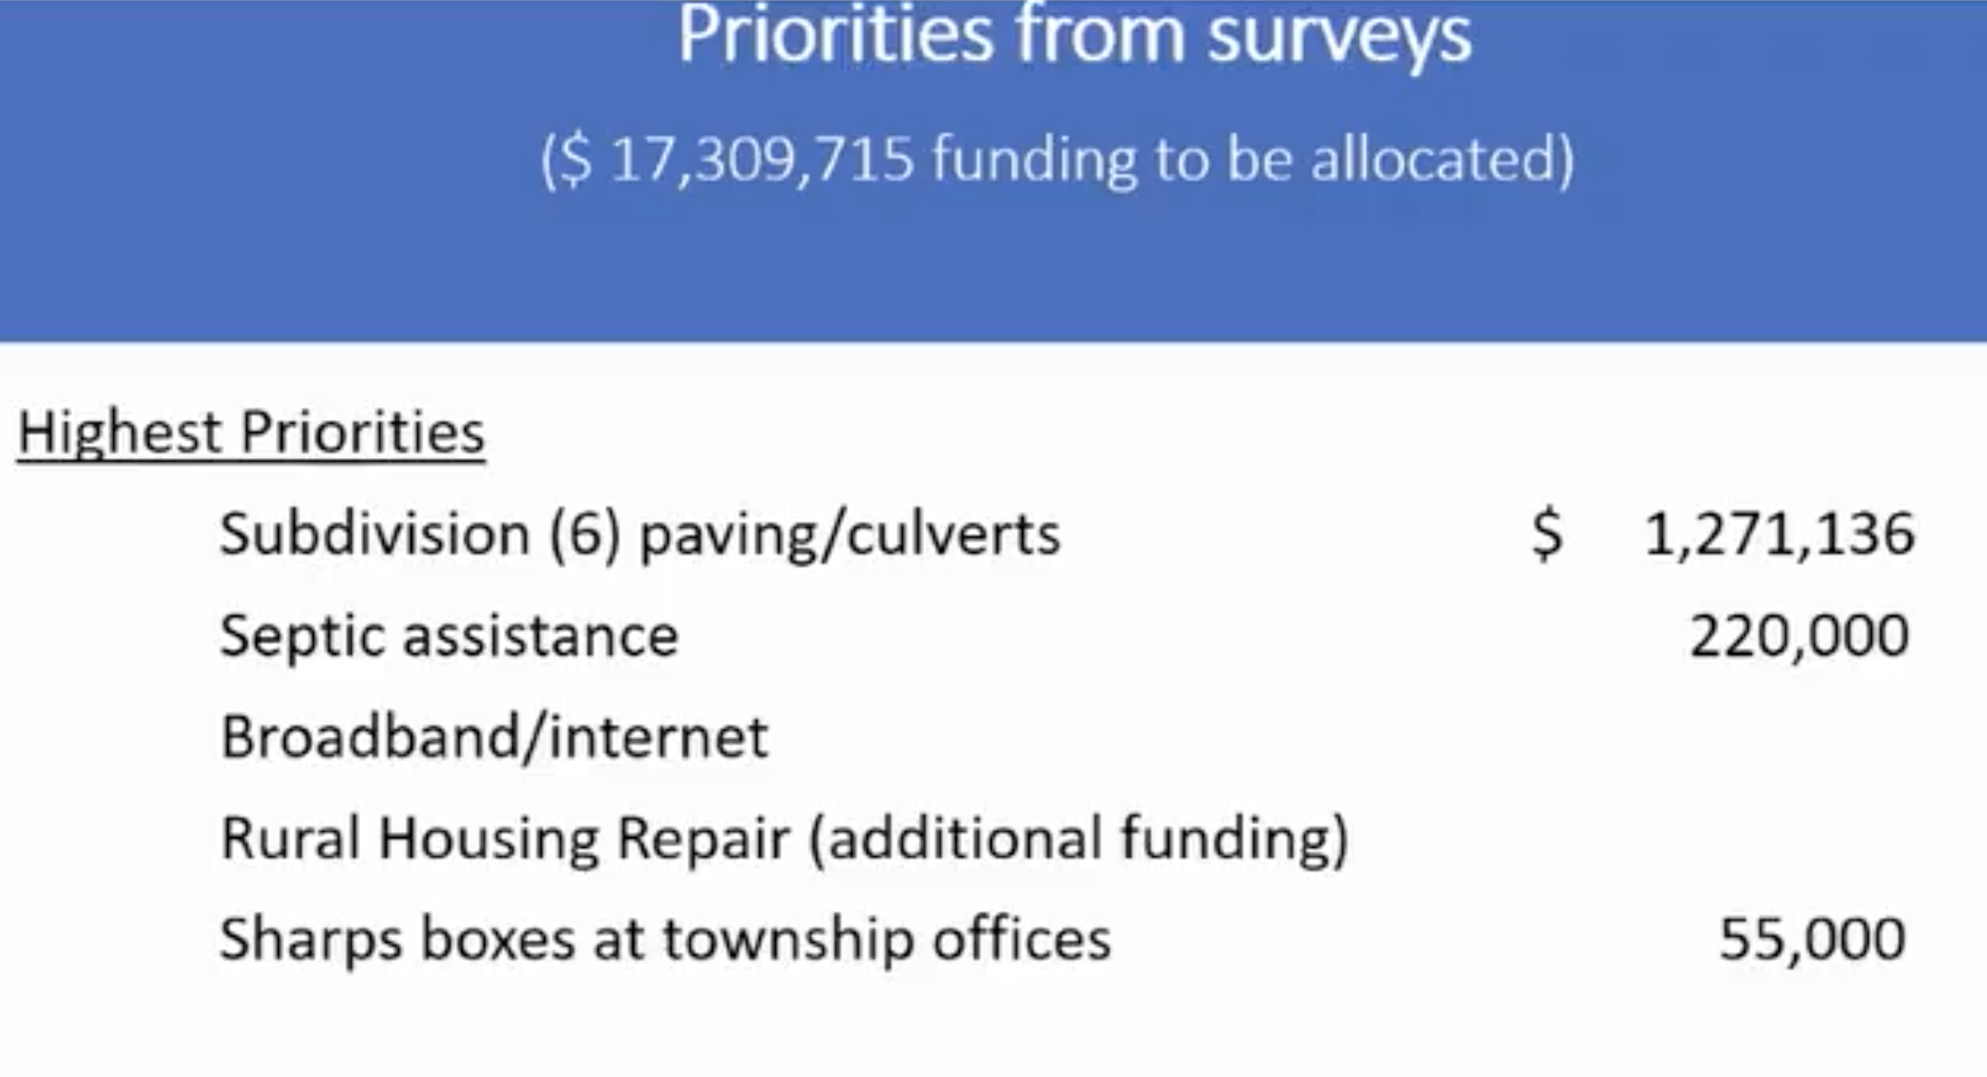

Emergency Jail repair line item was added
BroadBand and rural housing repair through trustees

Slide 9
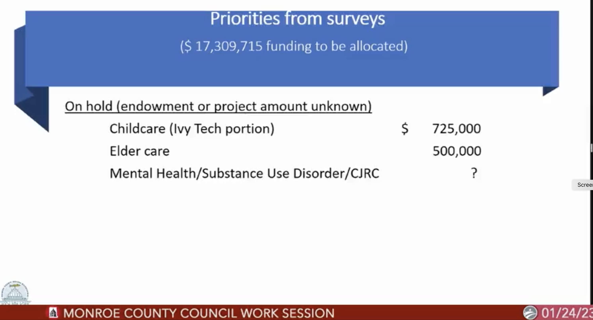
“I guess on the mental health, substance use disorder CJRC, I definitely like having that all wrapped in the umbrella of CJRC.”

Slide 10

“I guess on the mental health, substance use disorder CJRC, I definitely like having that all wrapped in the umbrella of CJRC.”
Quote from MCCC WS
IS Mental Health Treatment - Criminal or Care?
Is Substance Abuse Disorder Treatment - Criminal or Care?
Is the community response to health care issues and the stresses of prolonged poverty a criminal response only?

Slide 11
Why not provide water to those in need?
Please Explain here

Slide 12
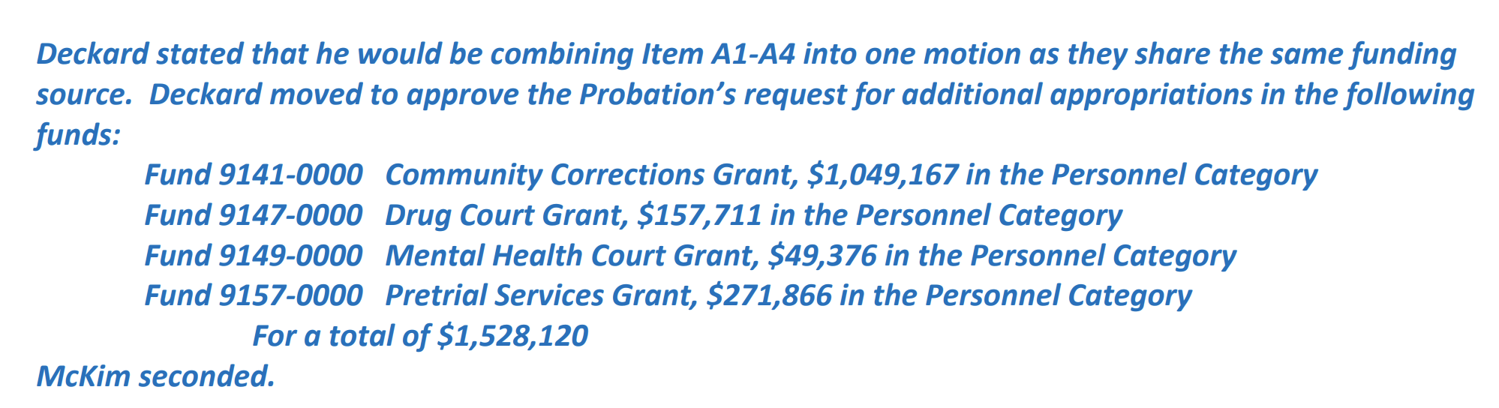
The Indiana Department of Correction (IDOC) awarded
Monroe Circuit Court Probation /Community Corrections a total of $1,528,120 in grant funds for the
Community Corrections Program, Pretrial Services,
and two Court Recidivism Reduction Programs -Drug Treatment Court and Mental Health Court.
This grant funding will support the continued operations of these
four programs for calendar year 2023
86% to Probation to expand Monitoring and Risk Assessment

Slide 13
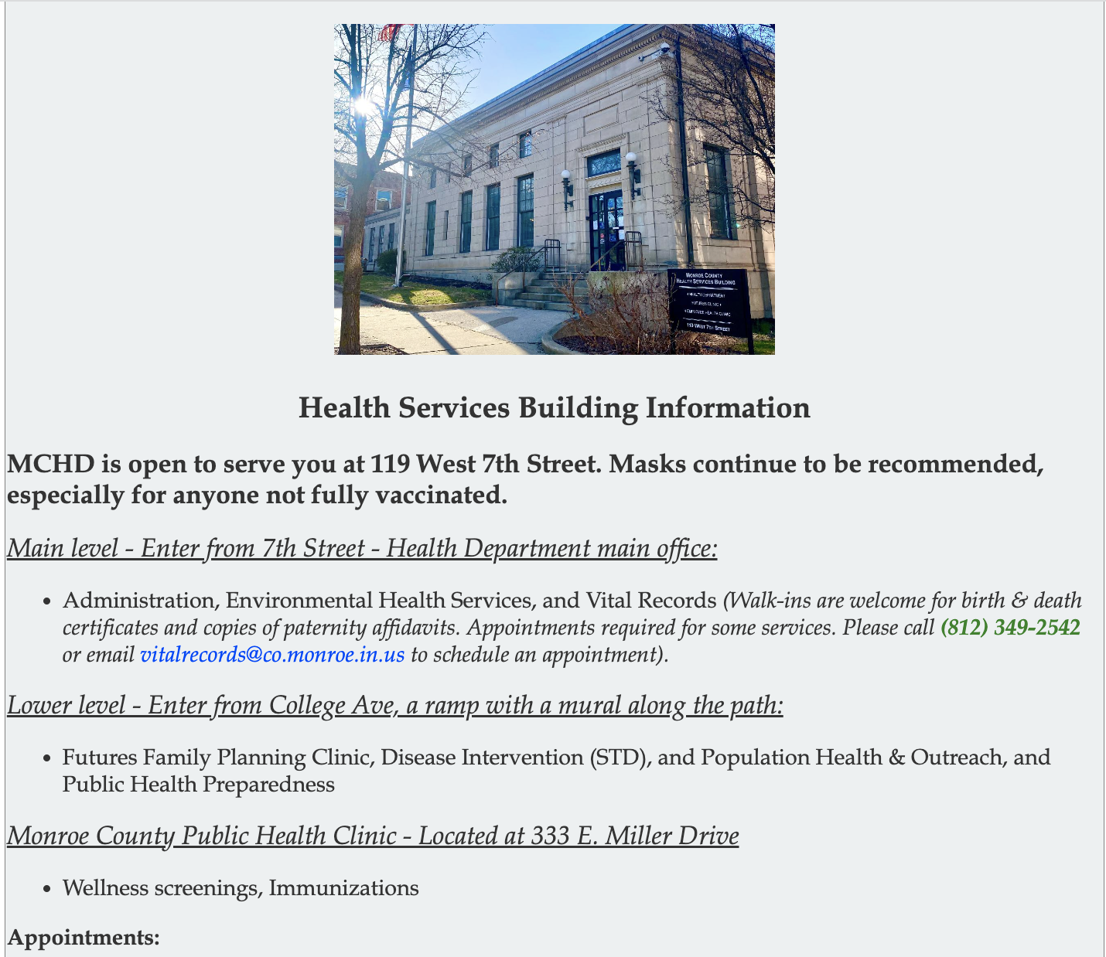
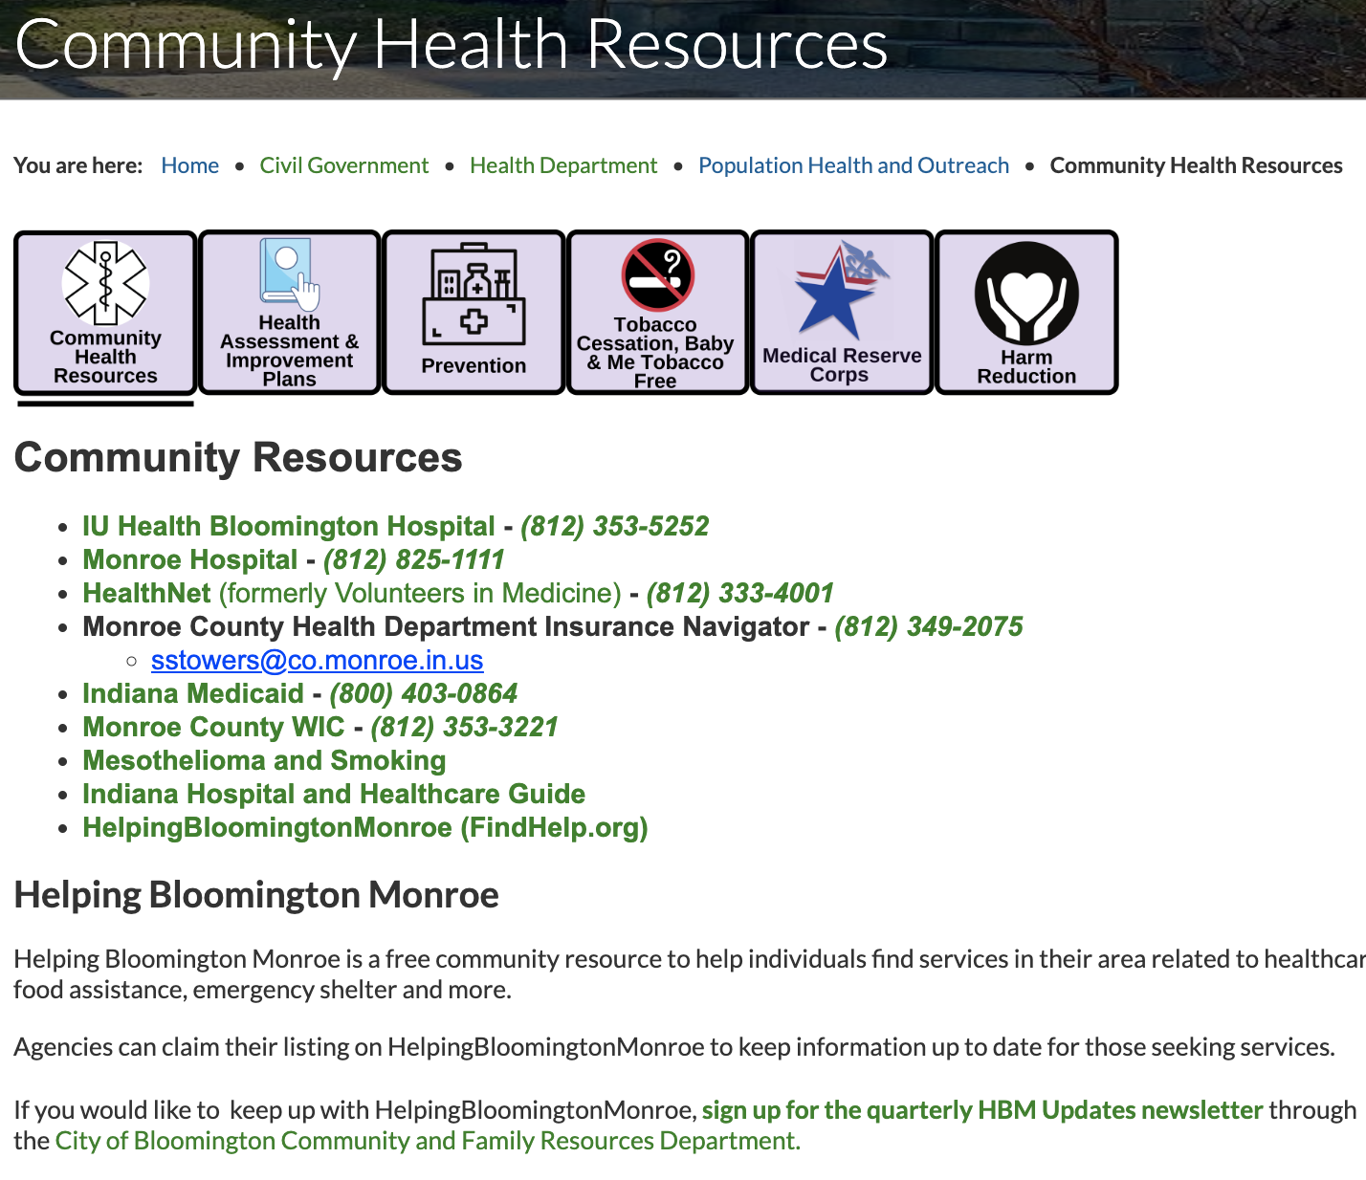

Slide 14
STOP

Slide 15
Notes from 1/18/2023
Monroe County Board of Commissioners Work Session
Presented by Commander Kyle Gibbons
191 residents and a rate of change of 20 people in/out per 48 hours
164 with felony charges and 18 with misdemeanor charges

